Slide 1
Introduction to .NET, C# and WPF
CT4027 – Tools Programming

Slide 2
What is .NET?
The .NET framework is a platform developed by Microsoft for developing various kinds of applications
The full .NET framework distributed by Microsoft runs only on Windows
Alternatives exist, such as Microsoft’s .NET core or Mono, which can run cross-platform
The .NET framework consists of a lot of libraries that can be used from client languages to develop .NET applications
C++, C#, Visual Basic, Cobol, Python, and F# can all be used as client languages, but we’re using C#, because it’s the most common, and certainly the best supported for application development
The .NET framework also contains the CLR or “common language runtime” – this runtime is used to execute all .NET applications

Slide 3
Executing a .NET program
A .NET program is compiled to CIL or “common intermediate language”
The CLR contains “just-in-time” compiler – this compiles CIL to machine code just prior to it being required in your program
This can happen once the program is already running, and allows for optimisations that cannot be performed on ahead-of-time compilers, such as the C++ compiler
Conversely, ahead of time compilers can produce very fast code nowadays, which will start up faster than a program that needs to be JIT compiled
Notes:
JIT compilers can optimise machine code generated for the machine that they are actually running on. For example C++ code may need to run on everything from a 386 chip to a modern I7. A JIT compiler knows what it is running on, knows that the code it’s compiling will be running on the same system, and can optimise specifically for that system.
Additionally, if a newer and faster version of the CLR is released, C# code that you wrote ages ago, when only the slower version was available, will now be able to run faster on this new version.
Finally JIT compilers can analyse how the code is working once it is actually running, and can do things such as inlining virtual methods (which would be impossible with an ahead of time compiler).

Slide 4

So is “just-in-time” faster or slower?
In theory – it could be just as fast
In the real world, it’s usually slower, but by a tiny amount
A lot of this is due to using higher-level abstractions – use the same abstractions in C++ and you will see similar performance
It does however, make programming a lot easier, as the .NET framework helps you in the background, and higher-level code is generally easier to use
Notes:
Check that they know what abstractions are – if not, explain this.
Can show on picture that .NET programs are using a lot more memory – and maybe touch on why – and explain that a lot of the extra slowness here is start-up time, so in a long-running application the difference would be even lower than it appears here.

Slide 5
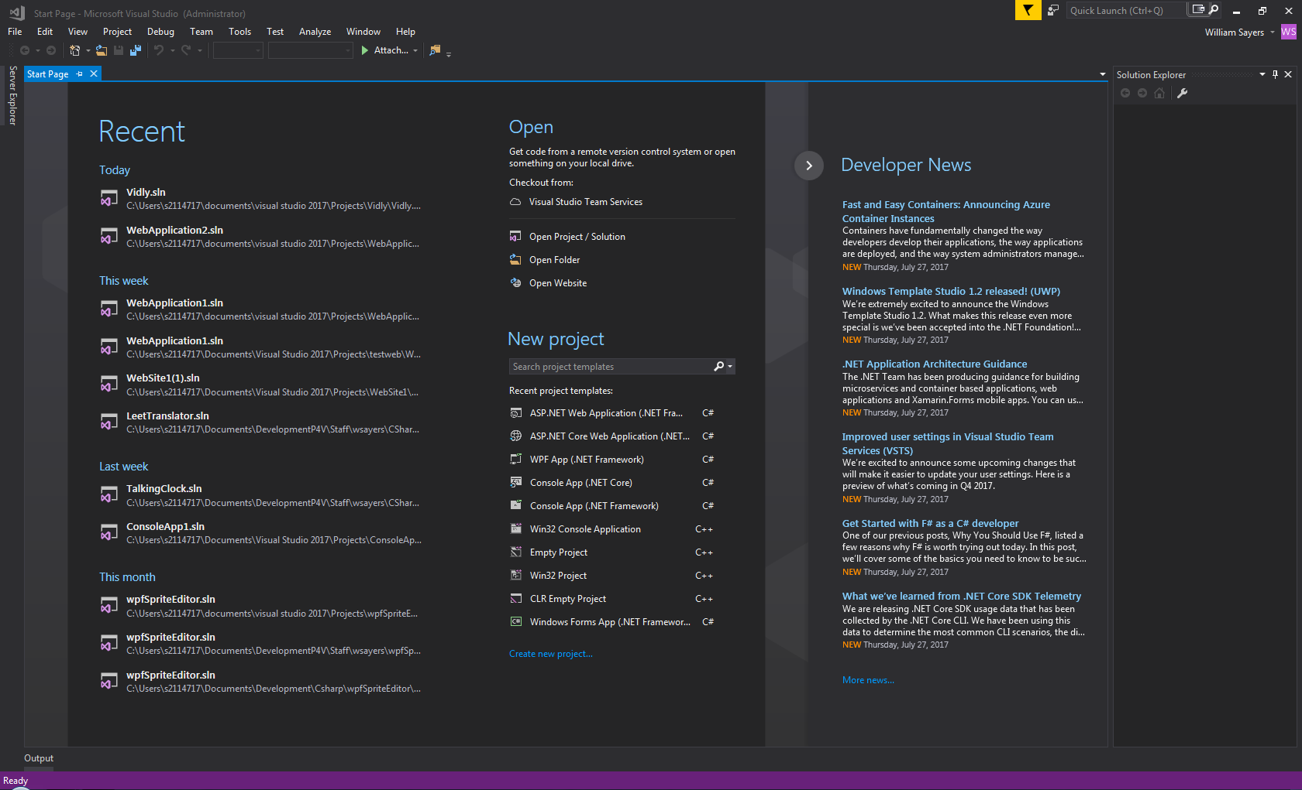
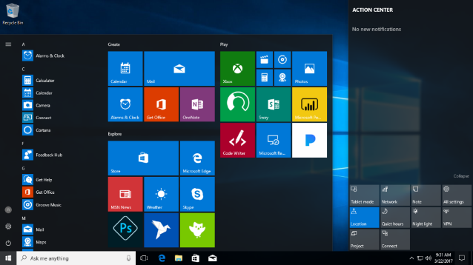

What can I code with .NET?
Almost anything you’re likely to want to
(provided it’s not an operating system for real world use, or a device driver).
Applications written in .NET include
Games (anything written with Unity, Xenko, Monogame)
Windows applications, large parts of Windows and Visual Studio itself are now written in C#
Large websites, stackoverflow (which you will become very familiar with as programmers) is based on a .NET stack
Notes:
Operating systems can be written in C#, but are generally ”toy” systems, for learning to code at an operating system level, rather than usable efforts.

Slide 6
Introduction to C#
C# is the most commonly used .NET language
Others include Visual Basic, IronPython, F# and Powershell
Traditionally, in a new programming language, you start out by creating a ”Hello World” program

Slide 7
Task #1 - Hello World
Please start Visual Studio 2019, load the first video on moodle in a browser, and follow along with that video to create a hello world program in C#
Then your first challenge is to make the program print “Hello [Your Name]” replacing [Your Name] with your name
When complete, save this solution somewhere ready to use again later

Slide 8
Congratulations
You’re now a C# programmer!
How long will it be until you’re an expert C# programmer?
Roughly ten years worth of programming regularly, or about 15,000 solid hours of effort is a common estimate
How long until you know everything about C#?
Pretty much impossible – new things are being added fast enough that learning everything without having forgotten things you’ve already learned, is pretty much impossible
So much has been added to .NET Core recently that even I’m struggling to keep up
So what will we achieve on this module?
A taste of coding in C# for Windows, so that hopefully, when combined with transferable knowledge from your other programming modules, that you can continue to learn by yourself

Slide 9
So what did you just code?
Console.WriteLine(”Hello World!”);
This line of code calls a built in function in C#, that writes text between (“ and “) to the screen, followed by a special character that moves to the next line
Console.ReadKey();
This line of code calls another built-in function, which pauses the program and displays a cursor, until the user presses a key

Slide 10
In-depth syntax
Examine the line of code: Console.WriteLine(”Hello World!”);
Let’s go through it bit by bit:
Console.WriteLine identifies the function we want to call
The parentheses “()” contains a list of items we want to send to the function, usually separated by commas, so we open the parentheses ”(“
In this case, we pass one “string” - a “string” in C# is a number of characters (letters) enclosed between two double-quotes “”. No commas are needed because we only pass one item
We then close the parentheses “)”
And finish with a semi-colon. Every “line” of code in C# ends with a semi-colon or a curly bracket “}”
Notes:
Question how many people managed to get the code to greet them personally, as a lead in
A function is a piece of code we can call on from our own code, that does things.
Items we send to the function are called parameters.

Slide 11
Therefore…
All we have to do to get a personal greeting, is to alter the string that is being passed to the function – as that is what is being printed to the screen.
Console.WriteLine(”Hello Will”);

Slide 12
Variables
What we’ve learned so far is useful, but limited
We can only print out what we’ve put into our code when we’re actually typing the code
It would be useful to be able to store information when we’re actually running our code and use it later
This is one thing we can use variables for
Variables let us assign a name to a location in memory, then store things in that location and refer to it by name

Slide 13
Types of Variable
Variables always* have an associated type in C#
A variable declaration usually follows the format:
[type] [variable name] [= initial value];
I.e. int numberOfPeople = 12;
There are many allowed variable types in C#
The main ones you will use are “int” for whole numbers, “string” for text, like peoples names, and float/double for numbers with decimal points (floating point numbers)
Additionally you can create your own types, and name them, then use them to store data, these are complex types.
Notes:
*There is such a thing as a dynamic variable, which still has an associated type, but the type is determined at run-time rather than at compile time. This is beyond the scope of this module, but worth noting as a concept that C# does support. Dynamic variables are best steered clear of unless they are a necessity, as you lose some of the benefits of type-safety.
For a full list of variable types available, see recommended reading, available on moodle

Slide 14
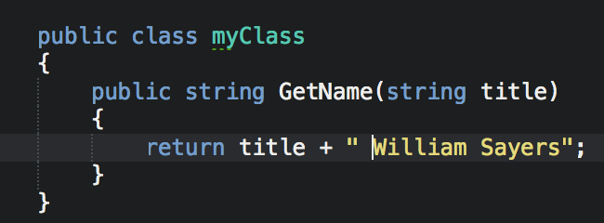
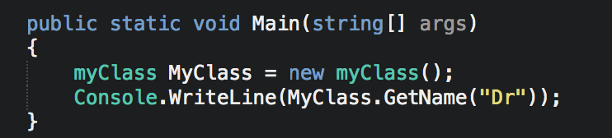
C# Methods
Methods in C# are a small section of code, with inputs, and outputs, which can be called from elsewhere in your code
They always live in classes or structs
They are declared and called as can be seen on the right

Slide 15
Task #2 – Methodical Hello
Please start Visual Studio 2019 and load your solution from before (if you shut down Visual Studio)
Load the second video on moodle in a browser, and follow along with that video to add a function to your hello world program, which passes information in and out using variables
Save this solution for use later

Slide 16
Complex types
The main complex types in C#, are enums, structs and classes.
The most commonly used is classes, as C# is an object oriented language (more on this later)
Followed by structs and enums
All of these complex types are some combination of other simpler types

Slide 17
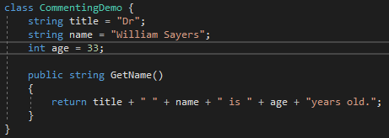
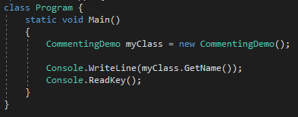
Classes
A class declaration looks like this
We have three variables, of different types
And a function, which concatenates a string together and returns it
We call that function from outside the class, as shown
Firstly creating a new copy of our class in memory (an instance)
Then using the name of that instance, a ‘.’ and then the name of the function on that class that we want

Slide 18
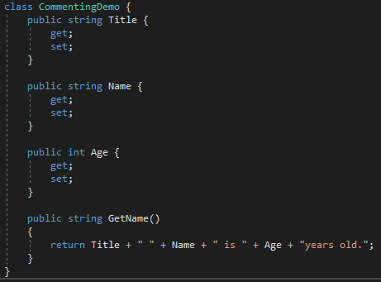
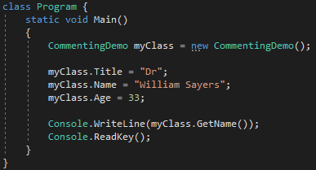
Class Properties
Variables inside a class are private by default (more on this later), so they cannot be accessed from outside the class
Variables can be made public, which allows access, but is bad practice
The correct method is to create a property instead of a public variable, as shown.
This allows you to access the variables using a ‘.’ notation, as shown

Slide 19
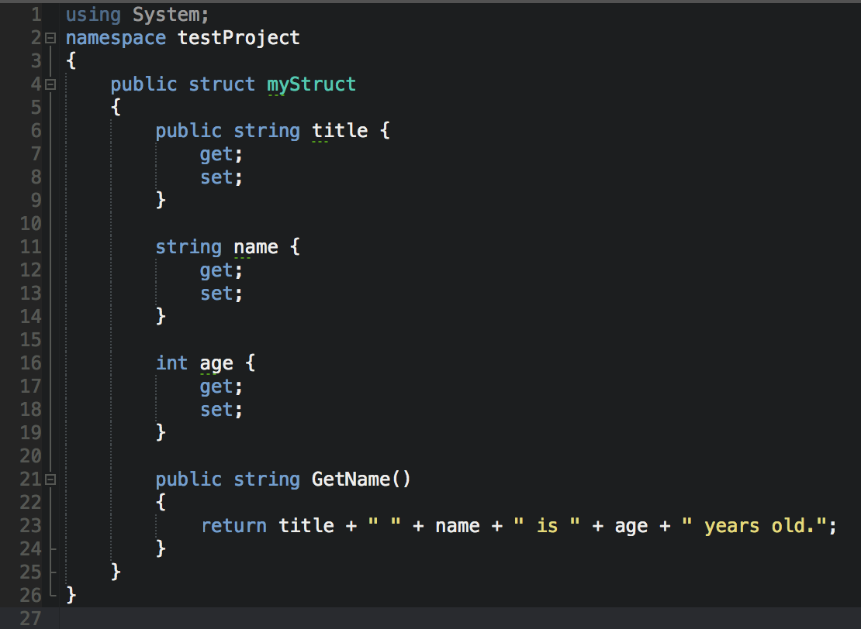
Structs
At first glance, structs in C# are very similar to classes
They are in fact, very different
Structs are value types as opposed to reference types
Structs do not support inheritance
Variables of struct types cannot be null
Generally, you probably want a class unless you know why you want a struct

Slide 20
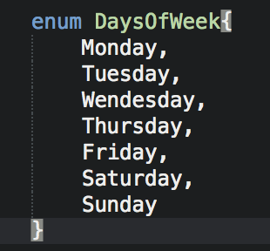
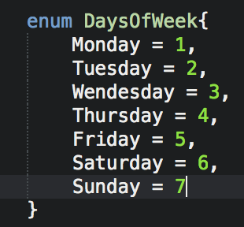
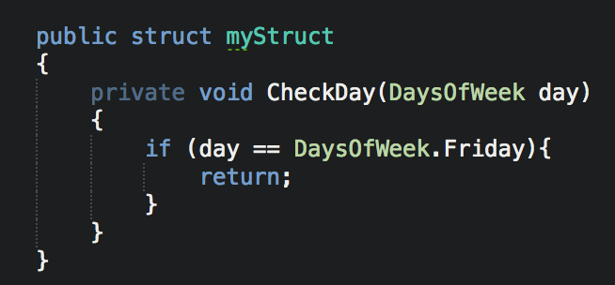
Enums
Enum is a shortening of “Enumeration”
An enum is basically a way of having a human-readable list of numerical constants
They can be defined as shown to the right
And used as shown in the image below

Slide 21
Task #3 – Hello Class
Please start Visual Studio 2019 and load your solution from before (if you shut down Visual Studio)
Load the third video on moodle in a browser, and follow along with that video to create a class-based hello program
Save this solution for use later

Slide 22
WPF – XAML
XAML is a domain-specific language for WPF (Windows Presentation Foundation), based on XML
Stands for “Extensible Application Markup Language”
In Visual Studio you can either drag and drop to create a user-interface, or code it directly in XAML
Coding in XAML will give you a live preview of the UI you’re building

Slide 23
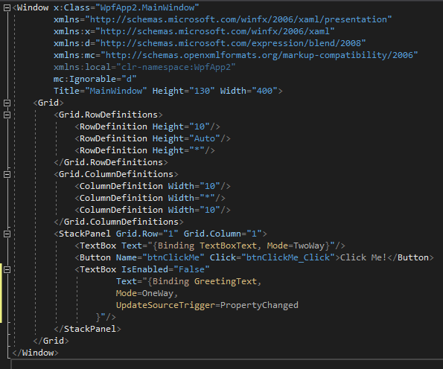
WPF - XAML
Looking at the example, it’s clear that XML is highly hierarchical
A Window contains a grid, a grid contains definitions of rows and columns, and a stackpanel, a stackpanel contains several other controls

Slide 24
WPF – XAML - Layouts
One of the easiest ways to build up basic user interface layouts is using nested grids and stackpanels, as shown
A grid allows you to organise controls in grids, you can specify sizes of rows and columns
A stackpanel piles controls one on top of the other, taking up the full horizontal width by default

Slide 25
Final Task
Tutorial to create a full text editor application in C# and WPF/XAML

Slide 26
Any Questions?

